Slide 1
Buffer Overflow
Lab 9

Slide 2
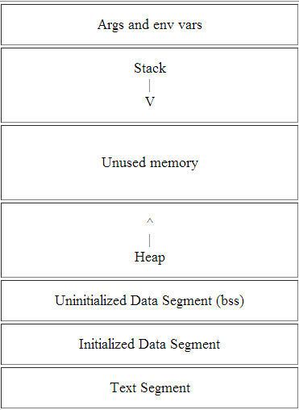
Process Memory Regions
Higher memory addresses
Fixed address
Stack pointer (SP) points to top of stack
Lower memory addresses

Slide 3
Stack Frame
Logical block
pushed when calling a function
popped when returning
Contains:
parameters to functions
local variables
data necessary to recover program state
Frame pointer points to fixed location within frame
variables are referenced by offsets to the FP

Slide 4
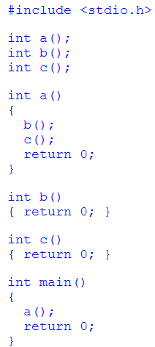
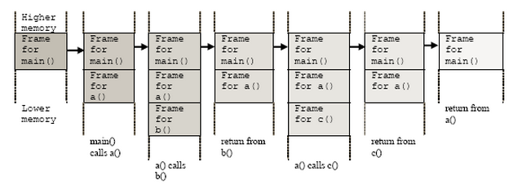
Function Calls

Slide 5
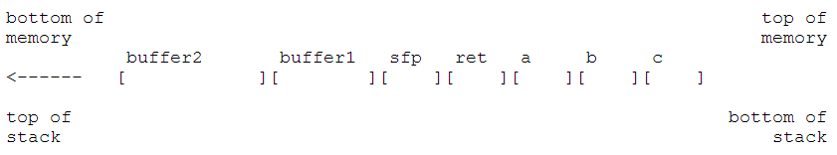
Constructing a Stack Frame
void function(int a, int b, int c) {
char buffer1[5];
char buffer2[10];
}
void main() {
function(1,2,3);
}
1. Push 3 arguments
2. Push return address
3. Copy SP into FP to create new FP and save it on the stack (SFP)
4. Advance SP to reserve space for local variables

Slide 6
Buffer Overflow
What is a buffer?
a contiguous block of memory that holds multiple instances of the same data type
What’s buffer overflow?
Stuffing more data into a buffer than it can handle
This common programming error can be taken advantage of to execute arbitrary code

Slide 7
Example
void copy(char *str) {
char buffer[16];
strcpy(buffer,str);
}
int main() {
char large_string[256];
int i;
for( i = 0; i < 255; i++) large_string[i] = 'A';
large_string[255] = '\0';
copy(large_string);
return 0;
}
strcpy() is copying the contents of *str (larger_string[]) into buffer[] until string NULL character
buffer[] is much smaller than *str. (16 bytes vs. 256 bytes)
All 240 bytes after buffer in the stack are being overwritten (INCLUDING the SFP and RET)
large_string is filled with the character 'A‘ (0x41)
RET = 0x41414141 which is outside of the process address space
When the function returns and tries to read the next instruction from that address
=> Segmentation Fault!!!

Slide 8
Buffer Overflow Example
Memory
Addresses
Parent Routine’s Stack Frame
Function Arguments
Return Address
Saved Frame Pointer
Char *bar
char buffer[16]
Unallocated Stack Space
Parent Routine’s Stack Frame
Function Arguments
Return Address
Saved Frame Pointer
Char *bar
char buffer[16]
Unallocated Stack Space
Parent Routine’s Stack Frame
A | A | A | A
A | A | A | A
A | A | A | A
A | A | A | A
A | A | A | A
A | A | A | A
A | A | A | A
Unallocated Stack Space
Stack
growth
buffer[15]
\0
o
buffer[0]
l
l
e
h

Slide 9
Exploiting Buffer Overflow
A buffer overflow allows us to change the return address of a function
We can change the flow of execution of the program and execute arbitrary code

Slide 10
How to Execute Our Code?
Place the code we are trying to execute in the buffer we are overflowing
Overwrite the return address so it points back into the buffer
Which code?
Spawn a shell so we can execute anything

Slide 11
Lab 9 – Steps 1 & 2
Build sthttpd: light-weight HTTP server and apply patch to introduce vulnerability
$ tar xvf sthttpd-2.26.4.tar.gz
$ cd sthttpd-2.26.4
$ patch –pNUM < patch_file
$ ./configure and make (with -fno-stack-protector)
Run it on port 12100 – 12327 (on Linux server)
./thttpd –p 12100
Run $ ps aux | grep thttpd, and make sure that no one else is using your port
Do a simple request like
wget http://localhost:12100

Slide 12
Crashing The Server
Send the web server a suitably-formatted request
$ wget http://localhost:12100/AAAA...AA
How many A’s should there be?
Where does the buffer overflow occur? Why?
Look at the code
Does it occur on the stack?

Slide 13
How To Crash The Server – Steps 3 & 4
Open 2 terminals and SSH into lnxsrv on both
Make sure you’re using the same lnxsrv for both (i.e. lnxsrv01, or lnxsrv02, etc. on both)
In 1st terminal
Run the web server under GDB and get traceback (bt) after the crash
./thttpd –p <port number>
Find the pid for thttpd
ps –aux | grep thttpd
Run gdb
$ gdb
$ (gdb) attach <pid>
In 2nd terminal
Send your crashing request using wget or curl
In 1st terminal
Continue (c), and when it crashes, do bt
Include this in lab9.txt

Slide 14
Steps 5 & 6
Describe how you would build a remote exploit in the modified thttpd
Smashing the stack for Fun and Profit
This lecture
-fstack-protector option
GCC flag that protects against stack-based overflow
Random canary is inserted after local variables, first thing to get corrupted
Arguments
Return Address
Frame Pointer
Canary
Local Variables

Slide 15
Lab Hints
How to create assembly language files (.s files)
Remove the .o file
$ rm thttpd.o
Edit Makefile using your favorite editor
$ vim Makefile
Search for ‘CFLAGS’ flag
Add -S after -O2
CFLAGS = -O2 –S
Save and quit
Make the removed .o file
$ make thttpd.o
You will see ‘thttpd.s’ or ‘thttps.o’ has been created with assembly code in it

Slide 16
Lab Hints
Adding options to ./configure and make
$ CC=gcc CFLAGS=options1 ./configure
$ CC=gcc CFLAGS='-fno-stack-protector' ./configure
$ CC=gcc CFLAGS=options1 make
$ CC=gcc CFLAGS='-fno-stack-protector' make
Options for CFLAGS
-fno-stack-protector
-fstack-protector
Or change CFLAGS in Makefile

